Slide 1

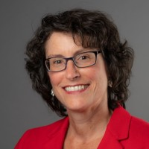
“Proceed as if success is inevitable.”
-Anonymous
Pivoting During a Pandemic:
Stories of Adaptability and Tips
It was a pleasure to be with you all!
Best wishes as you continue your journey!
-- Margaret Clarkson, MBA, PMP
linkedin.com/in/margaretclarkson
Highlighted Resources:
Ross Squire (of Knowledge Staff) – Tuesday nights Ross has a zoom for talent development job seekers (tell him I referred you)
Patricia Romboletti – Thursday nights Pat has a zoom for job seekers of all
professions

Slide 2


Books

